Slide 1

DATABASE COURSE 2023/2024
SESSION 11

Slide 2
SESSION 11
INDEXES
TRIGGER

Slide 3
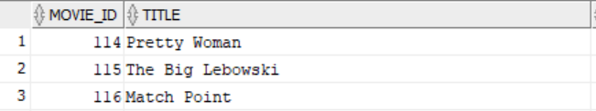

INDEXES
Query on table with no index
BBDD/User: moviebig
MySQL/Oracle
SELECT * FROM moviebig WHERE movie_id = 453;

Slide 4
INDEXES
CREATE INDEX Syntax
MySQL/Oracle
CREATE INDEX IndexName ON table(Field1,Field2,...);
MySQL/Oracle
CREATE UNIQUE INDEX IndexName ON table(Field1,Field2,...);
NOTE: Unique Index are automatically created at Primary Key creation

Slide 5
INDEXES
Query on a indexed column
BBDD/User: moviebig
MySQL/Oracle
CREATE INDEX idx_movieid
ON moviebig(movie_id);
1… 100
101 … 200
201 … 300
301 … 400
401 … 500
…
Branch Nodes
1 .. 10
11 .. 20
401 ..410
451 ..460
MySQL/Oracle
11 , RowID 12 , RowID …
20 , RowID
401 , RowID 402 , RowID …
410 , RowID
451 , RowID 452 , RowID …
460 , RowID
1 , RowID 2 , RowID …
10 , RowID
SELECT * FROM moviebig WHERE movie_id = 453;
Leaf Nodes

Slide 6
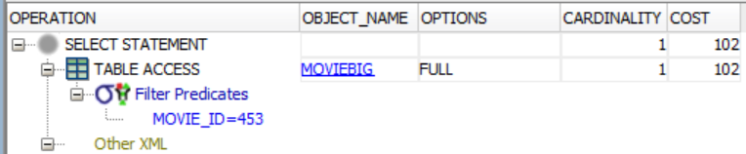
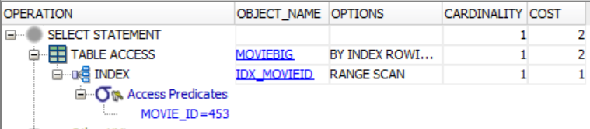
INDEXES
CREATE INDEX Example
BBDD/User: moviebig
MySQL/Oracle
SELECT * FROM moviebig
WHERE movie_id = 453;
MySQL/Oracle
CREATE INDEX idx_movieid ON moviebig(movie_id);
MySQL/Oracle
SELECT * FROM moviebig
WHERE movie_id = 453;

Slide 7
INDEXES
DROP INDEX Syntax
MySQL
ALTER TABLE table DROP INDEX IndexName
DROP INDEX IndexName ON table
Oracle
DROP INDEX IndexName

Slide 8
INDEXES
DROP INDEX Example
BBDD/User: world
MySQL
ALTER TABLE moviebig DROP INDEX idx_movieid;
DROP INDEX idx_movieid ON movie;
Oracle
DROP INDEX idx_movieid;

Slide 9
SESSION 11
INDEXES
TRIGGER

Slide 10
TRIGGERS
CREATE TRIGGER Syntax
MySQL/Oracle
CREATE TRIGGER TriggerName
EXECUTIONWHEN TRIGGEREVENT ON table
FOR EACH ROW
DECLARE
-- Variable Declaration
BEGIN
-- Code to executed
END;
EXECUTIONWHEN takes on of the following Values:
BEFORE
AFTER
TRIGGEREVENT takes on of the following values:
DELETE
INSERT
UPDATE
Oracle allows more than one separated by “OR”. Mysql does not.

Slide 11
TRIGGERS
CREATE TRIGGER Example
BBDD/User: people
MySQL
Oracle
CREATE TABLE paudit (
modifiername VARCHAR(50),
modificationdate DATE,
previousname VARCHAR(50),
newname VARCHAR(50));
CREATE TABLE paudit (
modifiername VARCHAR2(50),
modificationdate DATE,
previousname VARCHAR2(50),
newname VARCHAR2(50));

Slide 12
TRIGGERS
CREATE TRIGGER Example
BBDD/User: people
MySQL
CREATE TRIGGER auditpeople BEFORE UPDATE ON people
FOR EACH ROW
BEGIN
INSERT INTO paudit VALUES (USER(),SYSDATE(),OLD.Name,NEW.Name);
END;
Oracle
CREATE TRIGGER auditpeople BEFORE UPDATE ON people
FOR EACH ROW
BEGIN
INSERT INTO paudit VALUES (USER,SYSDATE,:OLD.Name,:NEW.Name);
END;

Slide 13
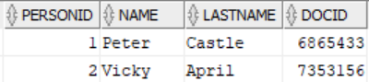



TRIGGERS
CREATE TRIGGER Example
BBDD/User: people
MySQL/Oracle
MySQL/Oracle
SELECT * FROM people;
SELECT * FROM paudit;
MySQL/Oracle
UPDATE people SET Name='Pedro' WHERE personid=1;

Slide 14
TRIGGERS
DROP TRIGGER Syntax
MySQL/Oracle
DROP TRIGGER TriggerName
DROP TRIGGER Example
BBDD/User: people
MySQL/Oracle
DROP TRIGGER auditpeople;

